Slide 1
A core Course on Modeling
Introduction to Modeling
0LAB0 0LBB0 0LCB0 0LDB0
c.w.a.m.v.overveld@tue.nl
v.a.j.borghuis@tue.nl
S.28

Slide 2
Conclude phase: interpret result
Reflection: interpret result
define
formulate
purpose
Right problem?
(problem validation)
conceptualize
identify
entities
choose
relations
Right concepts?
(concepts validation)
formalize
obtain
values
formalize
relations
Right model?
(model verification)
execute
operate
model
obtain
result
Right outcome?
(outcome verification)
Right answer?
(answer verification)
conclude
present
result
interpret
result
Notes:
2

Slide 3
Confidence for Black Box models
Black box models have empirical data as input.
Quantities try to capture essential behavior of this data.
Quantities typically involve aggregation.
Most common aggregations:
average,
standard deviation,
correlation,
fit.
univariate: every item = single quantity
bivariate: every item = pair of quantities
Notes:
3

Slide 4
Confidence for Black Box models
Average (μ):
the central tendency in a set
(for mathematical details, see courses in statistics)
http://cdn.morguefile.com/imageData/public/files/j/jdurham/preview/fldr_2009_02_12/file9761234479624.jpg
Notes:
4

Slide 5
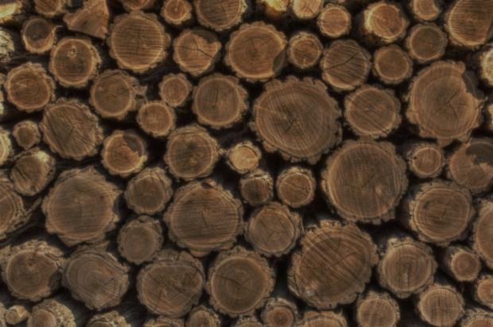
Confidence for Black Box models
Standard deviation (σ; variance is σ²):
how much variation does a set contain
http://www.morguefile.com/archive/display/852525
Notes:
5

Slide 6
Confidence for Black Box models
Correlation (ρ):
what is the agreement between two sets
(= a measure for similarity)
http://www.morguefile.com/archive/display/112388
Notes:
6

Slide 7
Confidence for Black Box models
fit: example of a extracting meaningful pattern from data:
Example: data set: (x_{i},y_{i}), assume linear dependency y=f(x).
Intuition: find a line y=ax+b such that the sum of squares of the vertical differences is minimal.
http://www.morguefile.com/archive/display/194905
Use a penalty to find the best fit line.
Penalty q = Σ(y_{i}-f(x_{i}))²
where f(x_{i}) = ax_{i}+b,
a and b are unknown.
…very bad
…still not good
…try again
…good (best?)
Notes:
7

Slide 8
Confidence for Black Box models
fit: example of a extracting meaningful pattern from data:
Example: data set: (x_{i},y_{i}), assume linear dependency y=f(x).
Intuition: find a line y=ax+b such that the sum of squares of the vertical differences is minimal.
http://www.morguefile.com/archive/display/194905
Use a penalty to find the best fit line.
Penalty q = Σ(y_{i}-f(x_{i}))²
where f(x_{i}) = ax_{i}+b,
a and b are unknown.
QUIZ
Is q indeed a penalty? How do you know?
Notes:
8

Slide 9
Confidence for Black Box models
fit: example of a extracting meaningful pattern from data:
Example: data set: (x_{i},y_{i}), assume linear dependency y=f(x).
Intuition: find a line y=ax+b such that the sum of squares of the vertical differences is minimal.
http://www.morguefile.com/archive/display/194905
Use a penalty to find the best fit line.
Penalty q = Σ(y_{i}-f(x_{i}))²
where f(x_{i}) = ax_{i}+b,
a and b are unknown.
Differentiate q = q(a,b) to a and b;
set $\frac{d}{da}q=\frac{d}{db}q=0$;
solve for a and b.
Notes:
9

Slide 10
Confidence for Black Box models
A black box model should explain the essence of a body of data.
Subtract the explained part of the data→leave little of the initial data.
For data (x_{i},y_{i}), ‘explained’ by a model y=f(x), the part left over is
Σ(y_{i}-f(x_{i}))² (residue).
http://www.morguefile.com/archive/display/858060
Notes:
10

Slide 11
Confidence for Black Box models
A black box model should explain the essence of a body of data.
Subtract the explained part of the data→leave little of the initial data.
For data (x_{i},y_{i}), ‘explained’ by a model y=f(x), the part left over is
Σ(y_{i}-f(x_{i}))² (residue).
http://www.morguefile.com/archive/display/858060
QUIZ
The numerical value of the residue could be anything. How do we know if the residu is acceptable or not?
Notes:
11

Slide 12
Confidence for Black Box models
A black box model should explain the essence of a body of data.
Subtract the explained part of the data→leave little of the initial data.
For data (x_{i},y_{i}), ‘explained’ by a model y=f(x), the part left over is
Σ(y_{i}-f(x_{i}))² (residue).
This should be small compared to
Σ(y_{i}-μ_{y})² (=what you would get assuming no functional dependency).
Therefore: confidence is high iff
Σ(y_{i}-f(x_{i}))²/ Σ(y_{i}-μ_{y})² is <<1.
http://www.morguefile.com/archive/display/858060
Notes:
12

Slide 13
Confidence for Black Box models
A black box model should be distinctive, that is: it should allow to distinguish input sets that intuitively are distinct.
Notes:
13

Slide 14
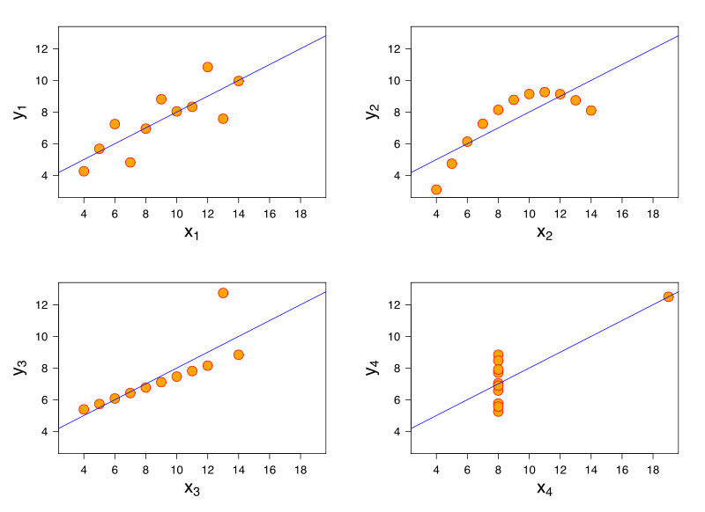
Confidence for Black Box models
Average, variance and least squares may not be very distinctive.
Anscombe (1973) constructed 4 very distinct data sets with equal average, variance and least square fits.
Hasty conclusion: ‘these sets are similar’ ... not!
Notes:
14

Slide 15
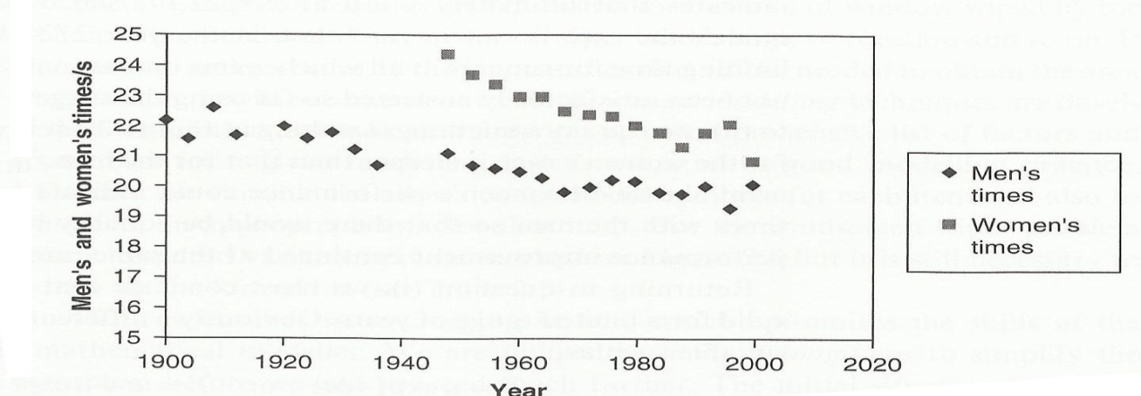
Confidence for Black Box models
Raw data is reasonably well explained by lin. least squares fit (low residue). So what?
Challenge hypothesis that raw data stems from one set. Cluster analysis reveals two sets.
http://www.morguefile.com/archive/display/193424
Notes:
15

Slide 16
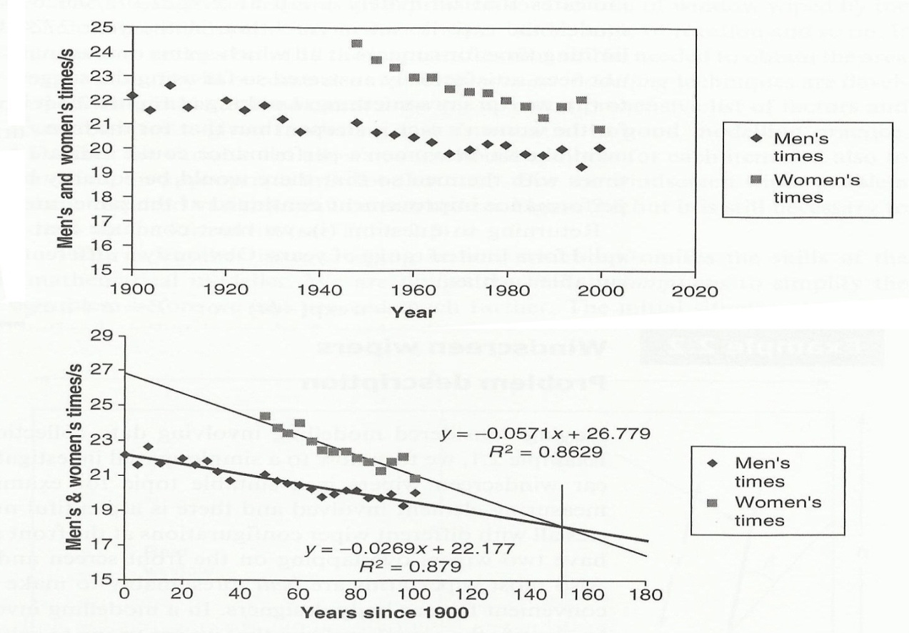
Confidence for Black Box models
Raw data is reasonably well explained by lin. least squares fit (low residue). So what?
Challenge hypothesis that raw data stems from one set. Cluster analysis reveals two sets.
Conclusion 1: women will overtake men in 2050 ?
Conclusion 2: men will break 0 second record around 2200 ?
http://www.morguefile.com/archive/display/193424
Notes:
16

Slide 17
Summary:
Black box models involve aggregation:
often a (linear least squares) fit, minimizing residues.
Values of (μ,σ, residue) don’t give a full characterisation of the data;
residual error: how much of the behavior of the data is captured in the model?
Distinctiveness (more on distinctiveness in chapter 7): how well can the model distinguish between different modeled systems?
Common sense: how plausible are conclusions, drawn from a black box model?
Notes:
17

